Slide 1
INSTITUTE OF ENGINEERING
DEPARTMENT: CIVIL
Bachelor of Engineering (Civil Engineering)
Environment Impact Assessment
OECE-105
8th Semester
Introduction
DISCOVER . LEARN . EMPOWER

Slide 2
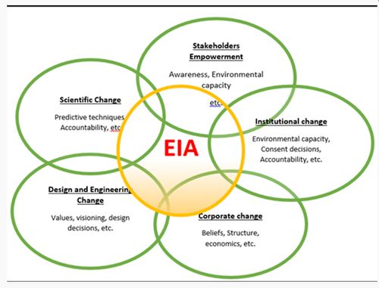
Introduction
Course Outcome
CO Number | Title | Level
1 | Interpret options for evaluating environmental and social impacts | Remember
2 | Understand the purpose of developing follow-up procedures, and options for designing these procedures | Understanding

Slide 3
OBJECTIVE OF THE TOPIC
To make students learn about Drastic effects on environment due to various on going projects
To give them the knowledge of various EIA techniques in India.
To help them learn the need for safe health and assessment of environment.
Help the students understand the safety of environment against Mega Projects.

Slide 4
FAQs
Why is EIA Conducted before the start of project is EIA carried out for various civil projects in India.
What are the various acts that are constituted in EIA Scheme in India?
What is the need of having a EIA Audit Policy?
Briefly Explain the features of EIA Audit Policy in India.
What is 1986 Draft EPA Policy? Give the Statement for same

Slide 5
Review: Definition of EIA
Environmental Impact Assessment is
✓
A formal process for identifying:
likely effects of activities or projects on the ENVIRONMENT, and on human health and welfare.
means and measures to mitigate & monitor these impacts
Environment is broadly interpreted: physical, biological, and social.
In EIA, the term “impacts” is used instead of “effects of activities.”
What is an impact?
Notes:
Aspects of the environment:
Physical: soil & water resources, air quality
Biological: fauna, flora, ecosystem
Social: human health and welfare, culture, religion, and local values
Or: Economical, social and eco-systemic

Slide 6
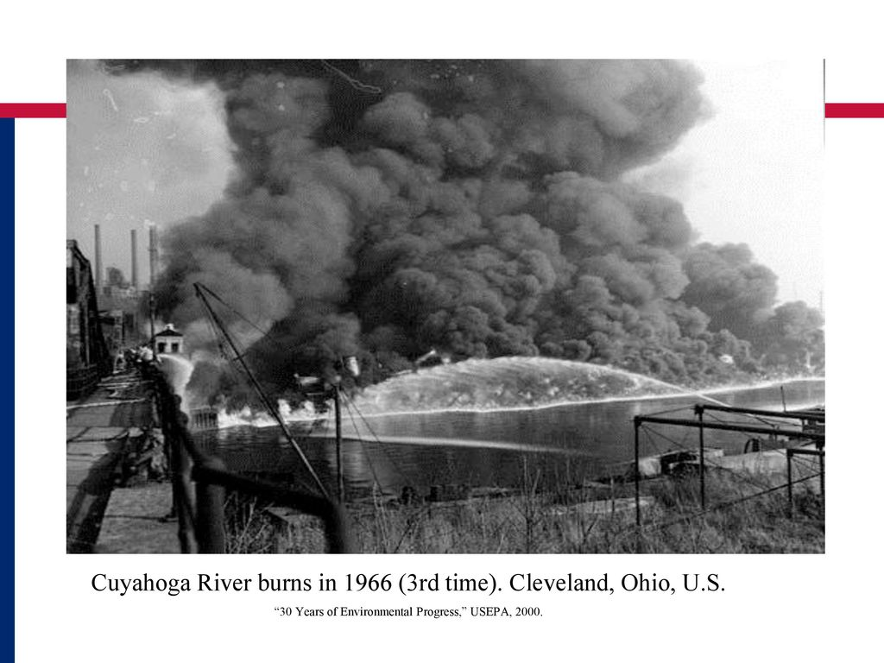

Why did EIA start?
By the early 1960s in the US and other industrial countries, it was clear that something was wrong Silent Spring by Richeal Carison

Slide 7
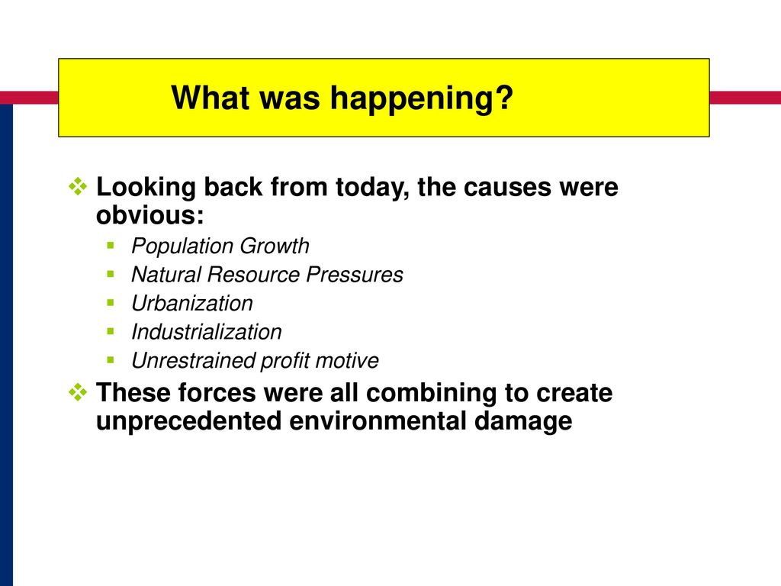

Slide 8
What is an impact?
The impact of an activity is a deviation (a change) from the baseline situation that is caused by the activity.
The baseline situation is the existing environmental situation or condition in the absence of the activity.
The baseline situation is a key concept in EIA.
To measure an impact, you must know what the baseline situation is.
!
More…

Slide 9
The baseline situation
Water Quantity, quality, reliability, accessibility
In characterizing the baseline situation, many environmental components MAY be of interest
Soils Erosion, crop productivity, fallow periods, salinity, nutrient concentrations
Fauna Populations, habitat
The components of interest are those that are likely to be affected by your activity—or upon which your activity depends for its success
Env Health Disease vectors, pathogens
Flora Composition and density of natural vegetation, productivity, key species
Special Key species ecosystems
Notes:
For example, an ecotourism activity might depend on water level in watering holes---but this environmental component is not in fact affected by your activity.

Slide 10
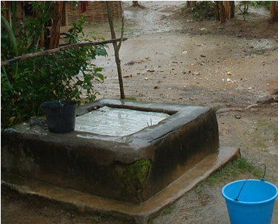
The baseline situation
The baseline situation is not simply a “snapshot.”
Describing the baseline situation requires describing both the normal variability in environmental components & current trends in these components.
Water table
time
This chart of groundwater levels shows both variability and a trend over time.
Both are part of the groundwater baseline situation.

Slide 11
Types of impacts & their attributes
Direct & indirect impacts
Short-term & long-term impacts
Adverse & beneficial impacts
Cumulative impacts
The EIA process is concerned with all types of impacts and may describe them in a number of ways
✵ Intensity  Direction
✵ Spatial extent  Duration
✵ Frequency  Reversibility
✵ Probability
But all impacts are NOT treated equally.

Slide 12
Specifically,
!
It is ESSENTIAL in EIA to focus on the most significant impacts.
Don’t waste effort & time analyzing and discussing impacts that are less important.

Slide 13
What is an activity?
We are discussing the impacts of activities. What are activities?
✓
An activity is:
a desired accomplishment or output
E.g.: a road, seedling production, or river diversion to irrigate land
Accomplishing an activity requires a set of actions
ACTIVITY: market access road rehabilitation | ACTIONS: Survey, grading, culvert construction, compaction, etc. . .
A project or program may consist of many activities

Slide 14
The EIA process
Phase I: Initial inquiries
Phase II: Full EIA study (if needed)
Understand proposed activities
Screen
Conduct preliminary assessment (if needed)
Scope
Evaluate baseline situation
Identify & choose alternatives
Identify and characterize potential impacts of proposed activity and each alternative
Develop mitigation and monitoring
Communicate and document
Our focus!

Slide 15
Phase 1 of the EIA Process
Phase I
Phase II
Understand proposed activity
Why is the activity being proposed?
What is being proposed?
Screen the activity
Based on the nature of the activity what level of environmental review is indicated?
Conduct a Preliminary Assessment
A rapid, simplified EIA study using simple tools (e.g. the USAID IEE)
SIGNIFICANT ADVERSE IMPACTS POSSIBLE
BEGIN FULL EIA STUDY
ACTIVITY IS OF MODERATE OR UNKNOWN RISK
SIGNIFICANT ADVERSE IMPACTS VERY UNLIKELY
ACTIVITY IS LOW RISK (Of its nature, very unlikely to have significant adverse impacts)
STOP the EIA process
ACTIVITY IS HIGH RISK (Of its nature, likely to have significant adverse impacts)

Slide 16

Phase 1 of the EIA process: Understand the proposed activity
Understand the proposed activities
Why is the activity being proposed?
What is being proposed?
ALL EIA processes begin with understanding WHAT is being proposed, and WHY.
The question “WHY IS THE ACTIVITY BEING PROPOSED? Is answered with the development objective (D.O.).
✗
✓
Not a D.O.!
Is a D.O.
“building a road”
“increasing access to markets”
“If we don’t understand it, we can’t assess it!”
We must understand the Development Objective to identify environmentally sound alternatives

Slide 17
Phase 1 of the EIA process: Understand the proposed activity
Understand the proposed activities
Why is the activity being proposed?
What is being proposed?
Once we understand the development objective, we must fully understand WHAT is being proposed.
This includes associated actions!
PRIMARY ACTIVITY: construction of diversion dam & irrigation canal
ASSOCIATED ACTIONS:
Survey
negotiate land tenure
construct borrow pit
establish construction camp
construct temporary diversion structure
dispose of soil, debris
“Oops. I forgot about the borrow pit.”
Notes:
Note that the difference between ACTIVITIES and ACTIONS is discussed in

Slide 18
Phase 1 of the EIA process: Screen the activity
Screen each activity
Based on the nature of the activity, what level of environmental analysis is indicated?
SCREENING is the process of asking a very basic set of questions about the nature of activity.
These questions:
do NOT require analysis.
do NOT require detailed knowledge about the proposed sites, techniques or methods
Example screening questions: Does the activity involve:
Penetration road building?
Large-scale irrigation?
Introduction of non-native crop or agroforestry species?
Notes:
Are these questions indicative of low-risk or high-risk activities

Slide 19
Phase 1 of the EIA process: Screen the activity
Screen each activity
Based on the nature of the activity, what level of environmental analysis is indicated?
screening classifies the activity into a RISK CATEGORY:
VERY LOW RISK
EIA process ends
VERY HIGH RISK
Do full EIA study
MODERATE OR UNKNOWN RISK
Do preliminary assessment
The outcome of the screening process determines the next step in the EIA process

Slide 20
Phase 1 of the EIA process: Screen the activity
!
Each donor agency and national EIA law has its own set of screening questions.
✓
Screening is the topic of an upcoming module

Slide 21
Phase 1 of the EIA process: The Preliminary Assessment
Conduct a Preliminary Assessment
A rapid, simplified EIA study using simple tools (e.g. the USAID IEE)
The purpose of a preliminary assessment is to provide documentation and analysis that:
Allows the preparer to determine whether or not significant adverse impacts are likely
Allows the reviewer to agree or disagree with the preparer’s determinations
Sets out mitigation and monitoring for adverse impacts
!
Screening determines whether the preliminary assessment is necessary

Slide 22
Phase 1 of the EIA process: The Preliminary Assessment
Typical Preliminary Assessment outline
1. Background (Development objective, list of activities)
2. Description of the baseline situation
3. Evaluation of potential environmental impacts
4. Mitigation & monitoring
5. Recommended Findings
For each activity it covers, a preliminary assessment has 3 possible findings:
The project is very unlikely to have significant adverse impacts. (EIA process ends)
With specified mitigation and monitoring, the project is unlikely to have significant adverse impacts
The project is likely to have significant adverse impacts (full EIA study is required)

Slide 23
What is mitigation?
Mitigation is. . .
✓
The implementation of measures designed to reduce the undesirable effects of a proposed action on the environment
Mitigation is the topic of an upcoming module!

Slide 24
To arrive at findings: Identify, Predict and Judge
Arriving at the FINDINGS in a preliminary assessment requires 3 steps:
1
Identify potential impacts
Many resources describe the potential impacts of typical small-scale activities.
2
Predict potential impacts
Determine which potential impacts are likely to become actual, and quantify these impacts to the extent possible.
3
Judge the significance of potential impacts
Determine whether the predicted impacts are indeed significant!
THIS WILL OFTEN DEPEND ON HOW EFFECTIVE THE PROPOSED MITIGATION MEASURES ARE!
Notes:
Predicting impacts can involve Quantitative analysis (simulation models, statistical analysis, etc)
It almost always involves qualitative analysis (professional judgment, intuitive reasoning, etc)

Slide 25
Subsequent modules. . .
✓
Present tools to assist in identifying & predicting impacts
Discuss the factors involved in judging significance

Slide 26
!
We only proceed to Phase II of the EIA process if Phase I indicates that a FULL EIA STUDY is required
Most small-scale activities do not require a full EIA study!

Slide 27
Phase 2 of the EIA process: The Full EIA study
!
A formal scoping process precedes the study to ID issues to be addressed
Analysis of environmental impacts is much more detailed
Alternatives* must be formally defined. The impacts of each alternative must be identified & evaluated, and the results compared.
Public participation is usually required.
A professional EIA team is usually required.
The full EIA study has very similar objectives and structure to a preliminary assessment.
However, the full EIA study differs in important ways:
!
!
*includes the project as proposed, the no-action alternative at least one other real alternative
!

Slide 28
Phase 2 of the EIA process: The Full EIA study
With a few additions, the basic outline of the preliminary assessment is the template for the steps involved in a full EIA study:
Basic steps of the full EIA study
Scope
Evaluate baseline situation
Identify & choose alternatives
Identify and characterize potential impacts of proposed activity and each alternative
Compare alternatives
Develop mitigation and monitoring
1. Background (Development objective, list of activities)
2. Description of the baseline situation
3. Evaluation of potential environmental impacts
4. Mitigation & monitoring
5. Recommended Findings
Communicate & Document throughout

Slide 29
Phase 2 of the EIA process: The Full EIA study
✓
In summary,
The full EIA study is a far more significant effort than the preliminary assessment.
It is reserved for activities for which screening or the preliminary assessment shows that significant impacts are likely.
Notes:
The purpose of a Full EIA study is not to find that impacts will not be significant. Its purpose is to allow an informed decision to be made about which significant environmental impacts may be acceptable to obtain a particular development objective. The preliminary assessment cannot serve this function.

Slide 30
Who is involved in EIA?
Public consultation is usually only REQUIRED for full EIA studies.
However, it is good practice for preliminary assessments because:
Predicting impacts is FACILITATED by broad-based public consultation; Judging significance is very difficult without it.
Transparency and accessibility require disclosure to stakeholders
Sponsor of the activity (usually commissions/conducts the EIA)
Regulatory agencies/ Review authorities
Broad-based public
Communities (men & women) Civil society Private Sector

Slide 31
Making EIA effective
To be an effective tool for ESD, EIA must be:
a Integral part of the project development cycle.
EIA is undertaken early enough to affect project design
Mitigation and monitoring developed in the EIA process is implemented.
Honest
The full EIA study must consider real alternatives
Impacts must be assessed honestly.
Transparent & accessible
The EIA products must be clear and accessible to key actors.

Slide 32
References
Environment Impact Assessment by Lawrence DP
Source Book on EIA – World Bank
Internet Sources – Google, Wikipedia & Slide Share.

Slide 33
THANK YOU

